Slide 1

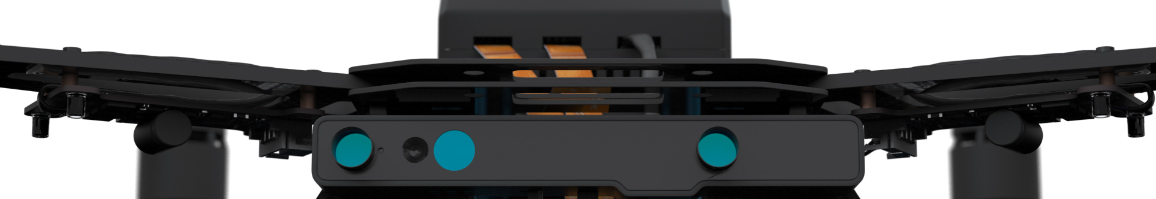
Autonomous Drone Engineer C3 – Ubuntu user installation
Paul.Guermonprez@intel.com Autonomous Drone Solutions Architect

Slide 2
Yocto vs Ubuntu
Intel is shipping Intel Aero (RTF Drone and Compute Board) with Yocto preinstalled and you should download and flash the updated version of this image to update the hardware when you receive it. This Yocto build is preconfigured and highly customized for Intel Aero.
In parallel to this Intel supported Yocto image, Intel is providing documentation and packages to let you install Ubuntu yourself, manually. We do NOT provide a prepackaged and customized version of Ubuntu.
Compared to Yocto, Ubuntu can be interesting for rapid prototyping and software development.
Yocto for a Ready-To-Fly experience or Ubuntu for prototyping and development, you have the choice.

Slide 3
Ubuntu: What works
If you install Ubuntu 16.04.3 x64 Desktop as you would on a typical computer, you’ll see the disk, graphics, ports and WiFi already work.
Without additional drivers, none of the cameras included in the RTF Drone will work. You’ll need kernel drivers from Intel. They are available as a repository. Note: It will enable the RealSense R200 camera only.
We also provide basic maintenance tools for flashing and the MAVLink network proxy.
https://github.com/intel-aero/meta-intel-aero/wiki/90-(References)-OS-user-Installation
Typical installation, simple repository, basic support.

Slide 4
Video recording of the installation

Slide 5
Programming with C/C++/Python
We provide the basic MAVLink network proxy. This this proxy, you can send your MAVLink messages to localhost:5760 as you would on our reference build. You can use the MAVLink library from the language of your choice (typically C/C++/Python).
Next, you’ll probably want to install the Intel RealSense SDK.
See the Software Architecture B4 presentation for more details.
Simple setup!

Slide 6
Programming with ROS
ROS is a major reason to use Ubuntu, as Ubuntu packages are well maintained by the ROS community.
Install ROS : https://github.com/intel-aero/meta-intel-aero/wiki/05-Autonomous-drone-programming-with-ROS
Add Intel RealSense node, to access the R200 camera
Add MAVROS, the MAVLink connection node
Connect your MAVLINK code to localhost:5760 (see Software Architecture B4 presentation)

Slide 7
Thanks
Paul.Guermonprez@intel.com
https://intel-aero.github.io
Released under Creative Commons-BY creativecommons.org/licenses/by/2.0/

